Slide 1


Module 2
SECTIONAL ORTHOGRAPHIC PROJECTION
Sheba Varghese
Assistant Professor,
Dept. Of Mechanical Engineering,
Room : A (310), KJSCE, Vidyavihar
Email : sheba@somaiya.edu

Slide 2
Precedence of Lines
Visible lines takes precedence over all other lines.
Hidden lines and cutting plane lines take precedence over center lines
Center lines have lowest precedence
NOTE:
When the Visible line coincides with hidden or center line
- Visible line is shown
Hidden line coincides with center line
- Hidden line is shown

Slide 3
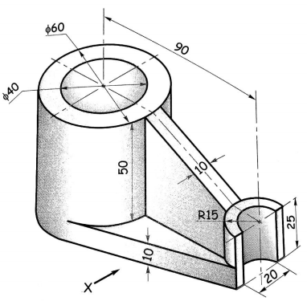
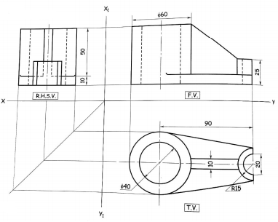
Orthographic projection

Slide 4
Sectional Orthographic Projection
For complicated objects when the hidden lines are large in number the drawing is difficult to interpret. To overcome this difficulty sectional orthographic projection is introduced.
In sectional orthographic projection the portion of an object which is cut is hatched by 45 degree incline thin line evenly placed.
As per cutting plane line position when section is assumed in one view it does not affect other views of object.
Visible lines behind the section are shown.
Invisible lines behind the section are usually omitted.

Slide 5
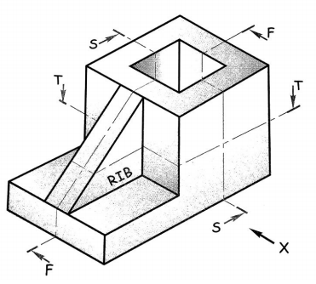
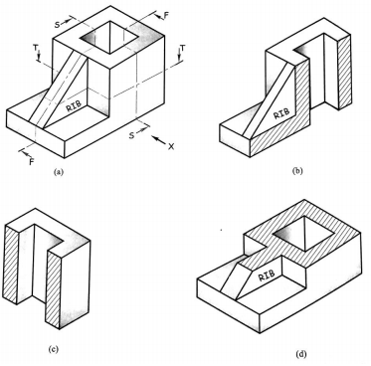
Sectional Orthographic Projection

Slide 6
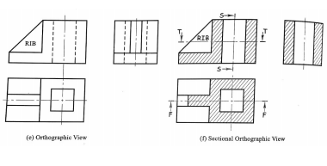

Slide 7
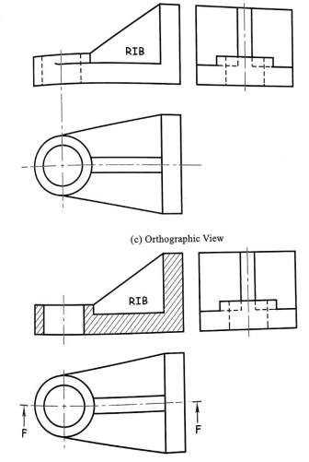
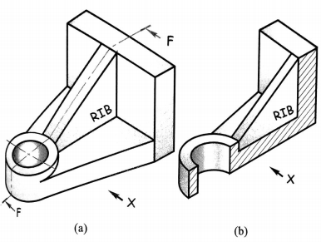

Slide 8
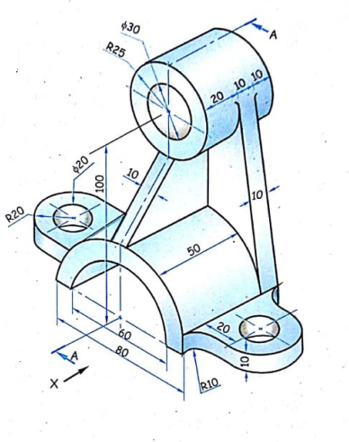
Draw the T.V, F.V & Section R.H.S.V

Slide 9
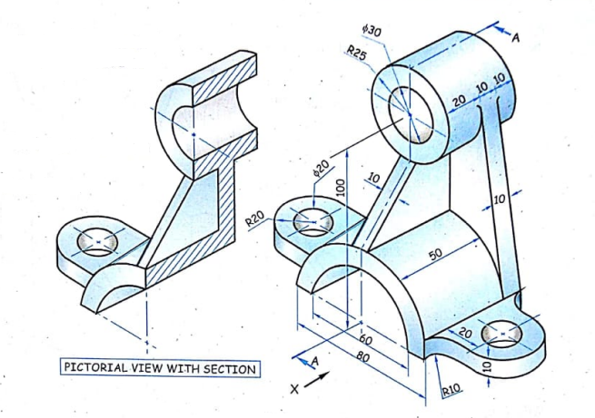
Draw the T.V, F.V & Section R.H.S.V

Slide 10
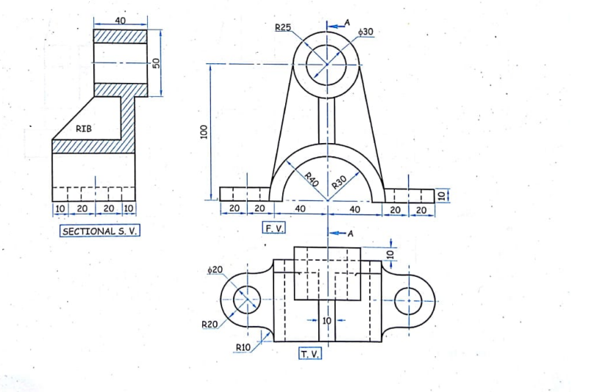
Draw the T.V, F.V & Section R.H.S.V

Slide 11
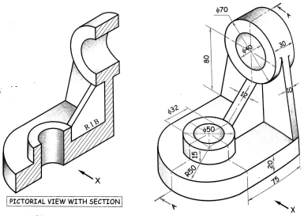
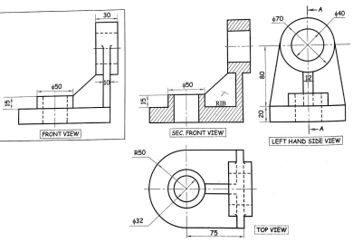
Draw the T.V, Sectional F.V & L.H.S.V

Slide 12
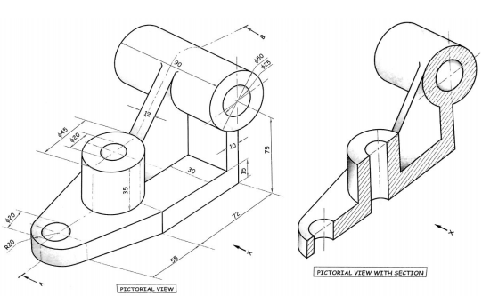
Draw the T.V, Sectional F.V & L.H.S.V

Slide 13
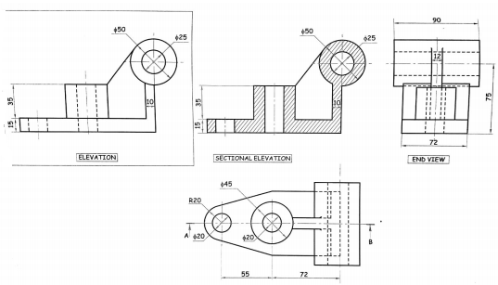
Solution

Slide 14
POINTS TO BE NOTED WHILE DRAWING SECTION LINES
Visible lines contained in the cutting plane and behind the section are drawn.
Invisible lines behind the section are usually omitted.
Only the parts actually cut by section are cross hatched with a continuous thin line at an angle of 45 degree to the major outline of the object.
The cutting plane line is shown in the view as a chain line with thick edges and arrow indicates the direction of the observer.

Slide 15
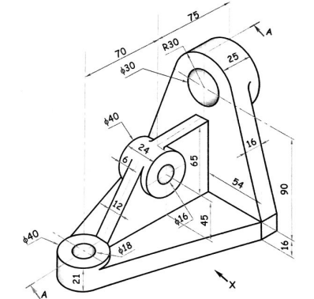
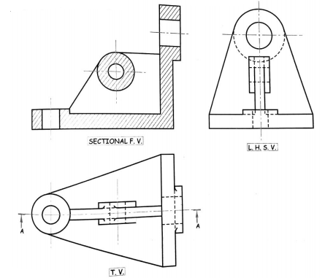
Draw the T.V , Sectional F.V & L.H.S.V

Slide 16
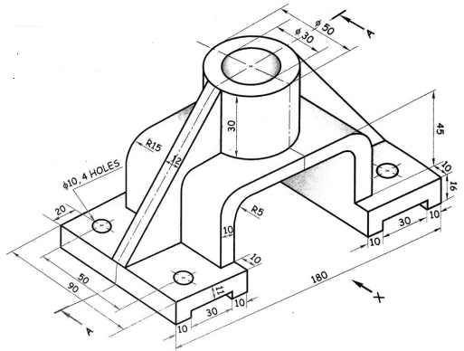
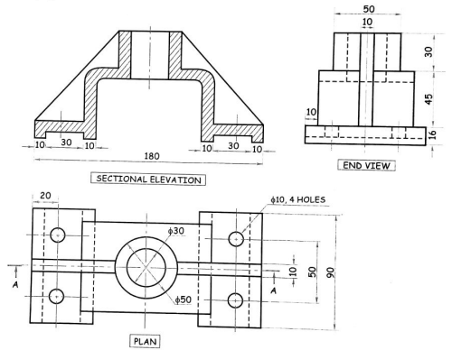
Draw the T.V, Sectional F.V & L.H.S.V

